Slide 1

SOCSE-DCET
Animal Disease Detection using Convolutional Neural Networks
MINI PROJECT - 2024
TY BTech CSE
Group-4
Sadhika Jain, PRN: 1032210508, Roll No. 01
Vaishvi Parikh, PRN: 1032211203, Roll No. 09
Moksh Oswal, PRN: 1032211205, Roll No.10
Pulkit Jain, PRN: 1032211319, Roll No. 12
Manav Chandak,PRN: 1032212171, Roll No. 29
Mini-Project Guide : Prof. Shakti Kinger

Slide 2
Problem Statement:
Animal Disease Detection using Convolutional Neural Networks
“The agricultural sector relies on healthy livestock for dairy production. Diseases like mange, cowpox, ringworm, and lumpy disease in cows can cause economic losses and threaten food security. This project aims to use Convolutional Neural Networks (CNNs) to develop a precise disease detection system for cows. By leveraging this project, we aim to streamline disease diagnosis, enabling early intervention and enhancing cattle health and productivity.”

Slide 3
Contents
Introduction
Literature survey
System Architecture Diagram
UML Diagrams
Activity Diagram
Sequence Diagram
Research Gap
Implementation
Applications
Conclusion
References
Questions and Answers

Slide 4
INTRODUCTION
Animal disease detection using Convolutional Neural Networks (CNNs) is crucial for safeguarding the health of cows, which are indispensable for their contributions to the dairy industry, agriculture, and various cultural practices.
Cows serve as a primary source of dairy products and play a significant role in the economy and societal customs. However, they face challenges such as disease outbreaks, environmental degradation, and decreasing populations.
CNNs offer a sophisticated solution for automating disease detection by analyzing vast datasets of cow health records and images. It allows for prompt treatment, minimizing suffering for the cow and preventing the spread of disease within the herd.
Healthy cows translate to increased milk production, benefiting both farmers and consumers.
Additionally, by enabling targeted treatment, CNNs can potentially reduce reliance on antibiotics in cows, contributing to a more sustainable food system.Timely detection of diseases enables prompt intervention and treatment, mitigating economic losses and ensuring the sustainability of dairy production.

Slide 5
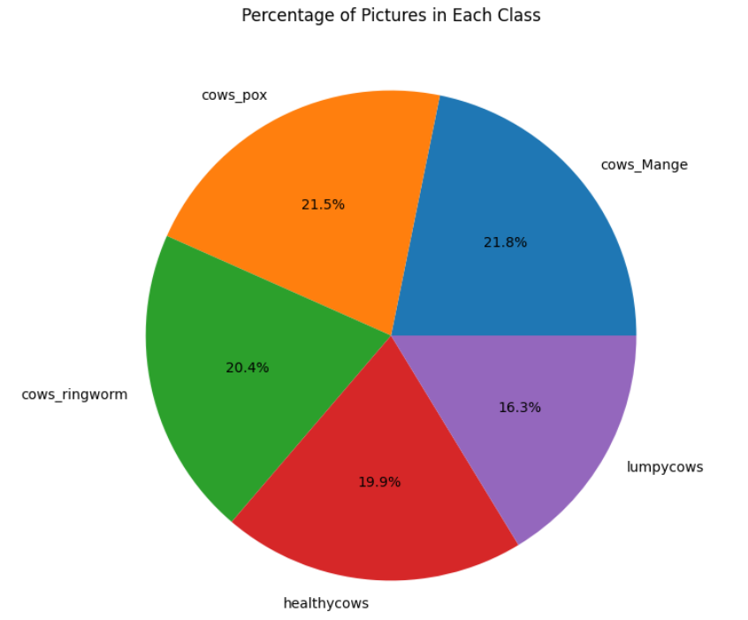
INTRODUCTION

Slide 6
Literature Survey
Sr No. | Publication Title with authors [ mention whether Journal or Conference paper] | Publication Year | Positive points of the Publication | Gaps in publication work
1 | Publication Title: "Design and Development of Leaf Disease Detection Using ML and OpenCV for Tomato Plants" Authors: Merrin Prasanna, N., Nagarau, C., Venkatesh, C., Subash Chandra Mouli, D., Riyazuddin, K., Rakesh Babu, B. Type: Journal (IEEE Access) | 2024 | Addresses the detection of leaf diseases in tomato plants using ML and OpenCV. Demonstrates the application of machine learning techniques in agricultural disease detection. | Focuses on plant diseases, not directly relevant to animal disease detection. Limited discussion on the transferability of the approach to other domains like animal health monitoring.
2 | Publication Title: "Plant Disease Classifier: Detection of Dual-Crop Diseases Using Lightweight 2D CNN Architecture" Authors: H. I. Peyal et al. Type: Journal (IEEE Access) | 2023 | Utilizes a lightweight 2D CNN architecture for plant disease detection. Addresses the challenge of dual-crop diseases, enhancing the applicability of the classifier. | Focuses on plant diseases, not directly relevant to animal disease detection. Limited discussion on the generalizability of the lightweight CNN architecture.
3 | Publication Title: "Dog Skin Diseases Detection and Identification Using Convolutional Neural Networks" Authors: A. Upadhyay, G. Singh, S. Mhatre, et al. Type: Journal (SN Computer Science) | 2023 | Focuses on the detection and identification of dog skin diseases using CNNs. Addresses a specific veterinary concern, demonstrating the potential of CNNs in animal disease detection. | Limited to dog skin diseases, may not generalize well to other animal species. Might lack scalability to handle diverse types of animal diseases.

Slide 7
Literature Survey
Sr No. | Publication Title with authors [ mention whether Journal or Conference paper] | Publication Year | Positive points of the Publication | Gaps in publication work
4 | Publication Title: "Classification of dog skin diseases using deep learning with images captured from multispectral imaging device" Authors: S. Hwang, H. K. Shin, J. M. Park, et al. Type: Journal (Molecular and Cellular Toxicology) | 2022 | Applies deep learning for the classification of dog skin diseases, addressing a practical veterinary concern. Utilizes multispectral imaging, providing richer data for disease classification. | Limited to dog skin diseases, may not directly translate to other animal species. Potential challenges in real-world implementation due to the requirement of multispectral imaging devices.
5 | Publication Title: "Skin Cancer Classification Using Convolutional Neural Networks: Systematic Review" Authors: T. J. Brinker et al. Type: Journal (Journal of Medical Internet Research) | 2020 | Provides a comprehensive systematic review of skin cancer classification using CNNs. Summarizes the state-of-the-art approaches, offering insights into successful methodologies. | Limited to skin cancer classification, not directly applicable to animal disease detection. Might lack recent advancements in CNN-based disease detection techniques.
6 | Publication Title: "Novel Dataset for Fine-Grained Image Categorization: Stanford Dogs" Authors: A. Khosla, N. Jayadevaprakash, B. Yao, and L. Fei-Fei Type: Journal (IEEE Journal on Computer Vision and Pattern Recognition) | 2018 | Introduces a novel dataset for fine-grained image categorization, specifically focusing on dog breeds. Enables researchers to develop and evaluate algorithms for fine-grained categorization tasks. | Primarily focuses on dog breeds, may not directly relate to disease detection tasks. Limited discussion on the application of the dataset in practical scenarios like disease detection.

Slide 8
Technologies Used
Classifiers Used -
CNN - Using OpenCV (cv2), images are loaded and preprocessed from the dataset directory for classification. Labels are encoded into a numerical format using scikit-learn LabelEncoder. The Keras Sequential API defines the CNN model architecture, employing Conv2D layers with ReLU activation functions to extract features from input images.
Multi-Layer Perceptron (MLP) Classifier - A Multi-Layer Perceptron (MLP) is a feedforward neural network model consisting of an input layer, one or more hidden layers, and an output layer. The input layer represents the features of the input data. Hidden layers perform transformations on the input data through weighted connections and activation functions. The output layer produces final predictions or classifications.
Interpreter -
Lime - The code utilizes Local Interpretable Model-agnostic Explanations (LIME) for image classification tasks. LIME explains each prediction by altering an input image and observing changes to the model's predictions, producing human-interpretable explanations. It generates a heatmap superimposed on the original image, highlighting the areas that influence the model's decision the most.

Slide 9
Research Gap
Within the field of livestock disease diagnostics, with a specific emphasis on cow illnesses, there has been a notable lack of research interest and limited availability of datasets for thorough analysis. Prior research has focused primarily on illnesses affecting other animals, with cows frequently receiving less attention. This deficit impedes the development of precise and customized diagnosis algorithms, as seen by the dearth of curated datasets unique to cow diseases.
Additionally, conventional machine learning techniques have been the mainstay of traditional approaches to disease categorization in cattle, thereby neglecting the potential of Deep Neural Networks (DNNs) in this field. Although DNNs have shown impressive results in a number of domains, their use in the categorization of cattle diseases has not yet received much attention. Among the many benefits of using DNNs is its capacity to automatically identify complex patterns from unprocessed data, which could result in more accurate and effective disease classification results.
By filling in these knowledge gaps, our work advances disease diagnosis in livestock—especially when it comes to cows—and pioneers the use of DNNs in this field, opening the door to more precise and effective diagnostic instruments for both livestock farmers and veterinary professionals.

Slide 10
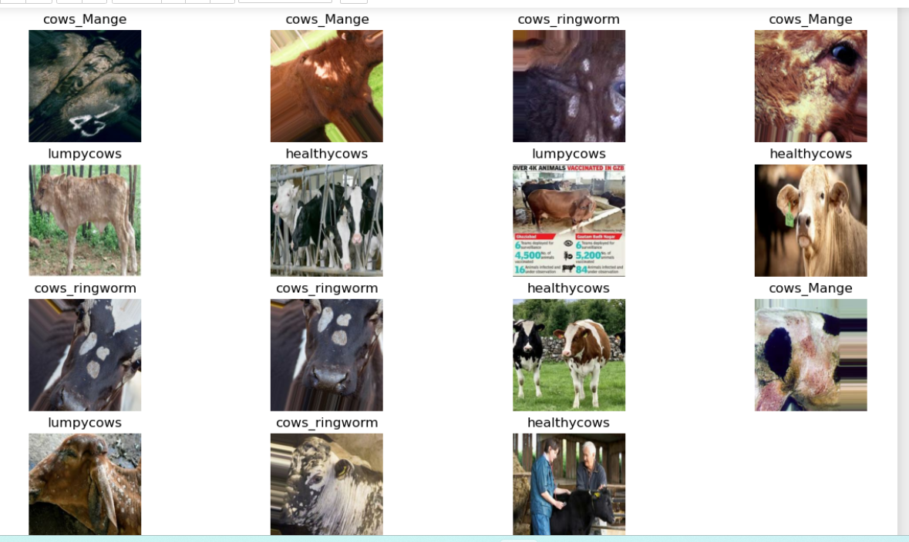
Dataset Generation

Slide 11
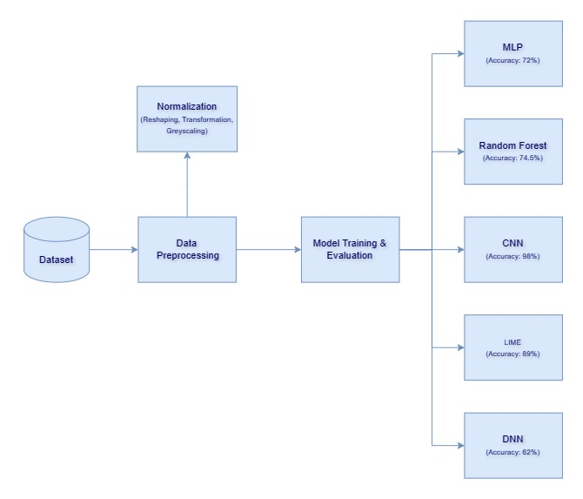
System Architecture Diagram

Slide 12
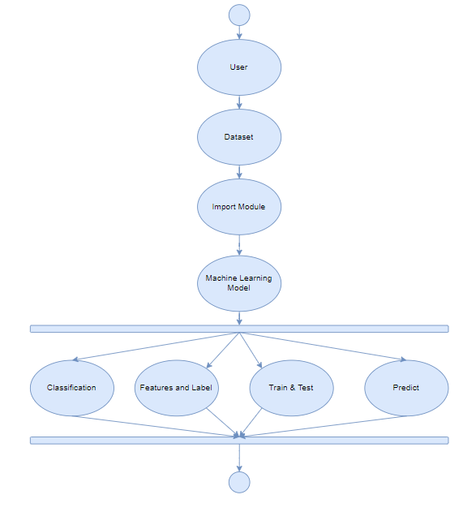
UML Diagram

Slide 13
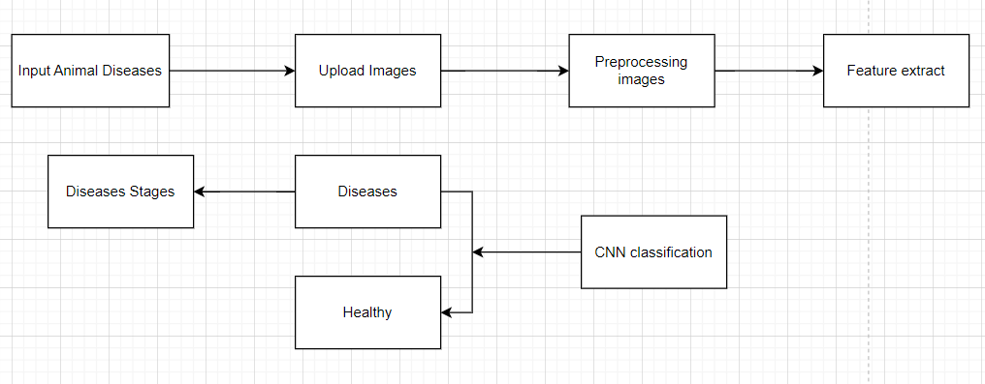
Activity Diagram

Slide 14
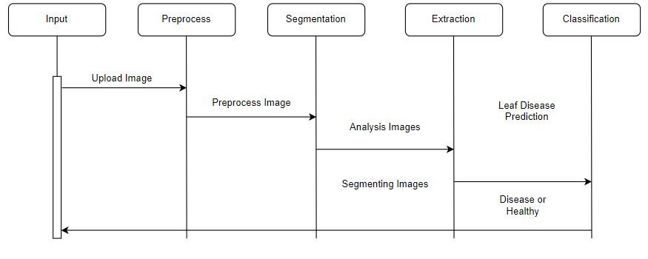
Sequence Diagram
Animal

Slide 15
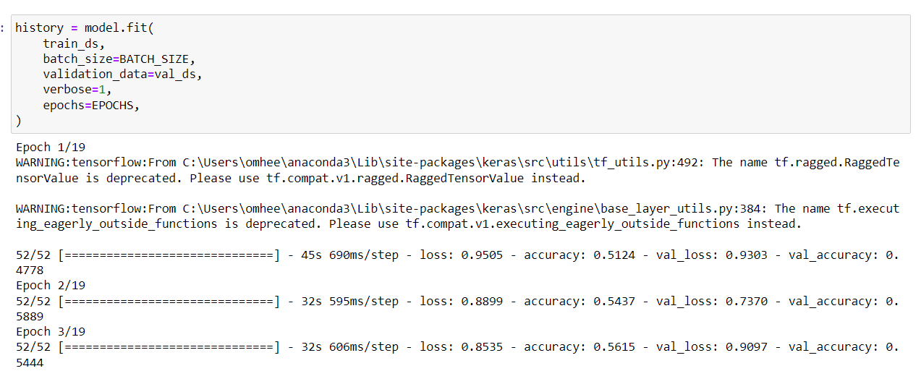
Implementation

Slide 16
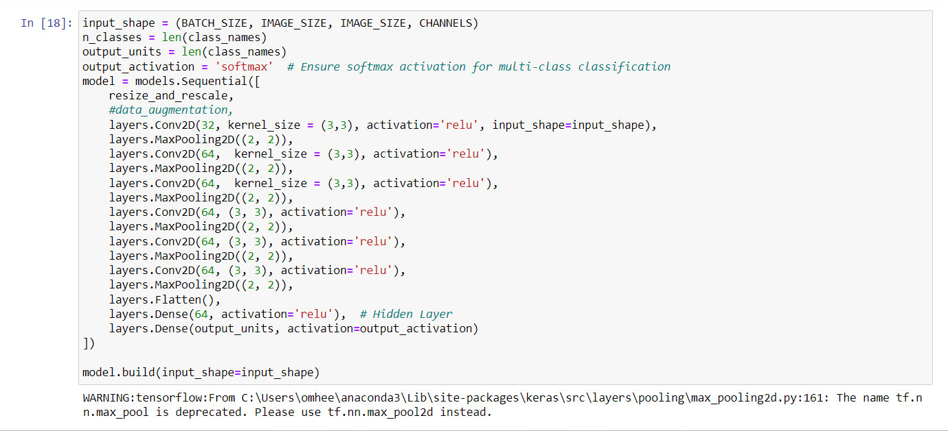

Slide 17
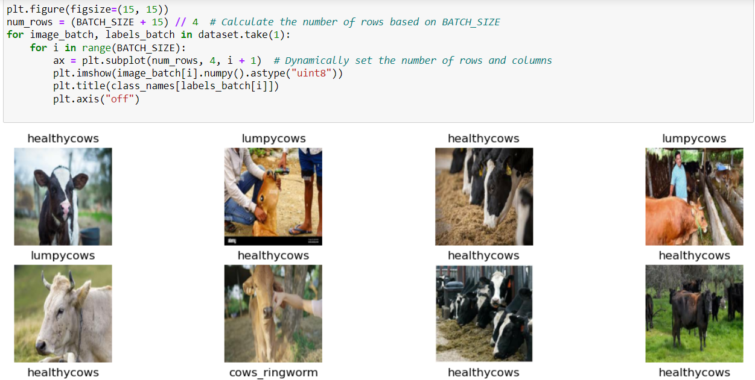

Slide 18
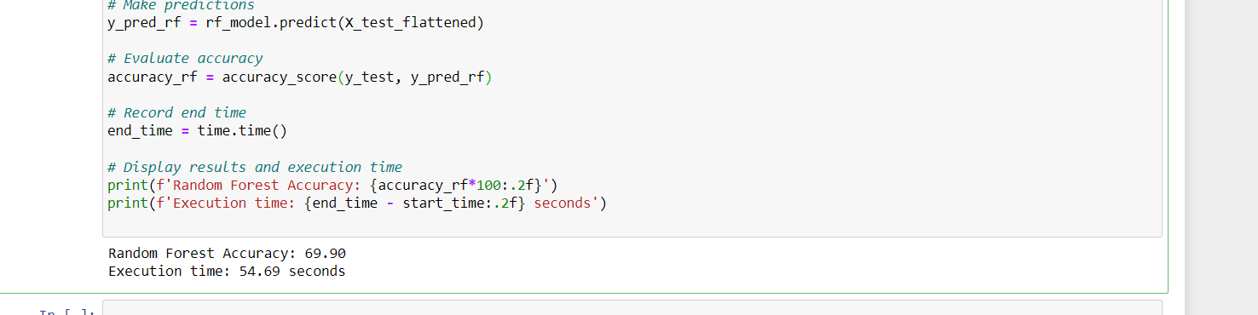

Slide 19
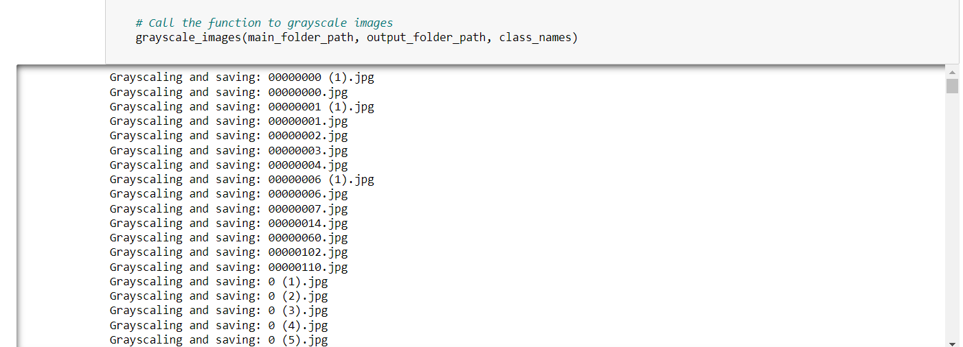

Slide 20
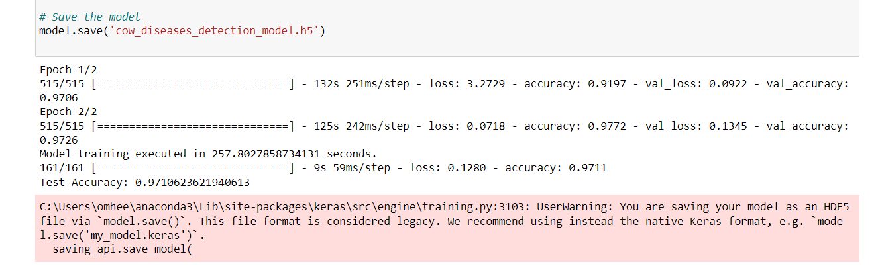

Slide 21
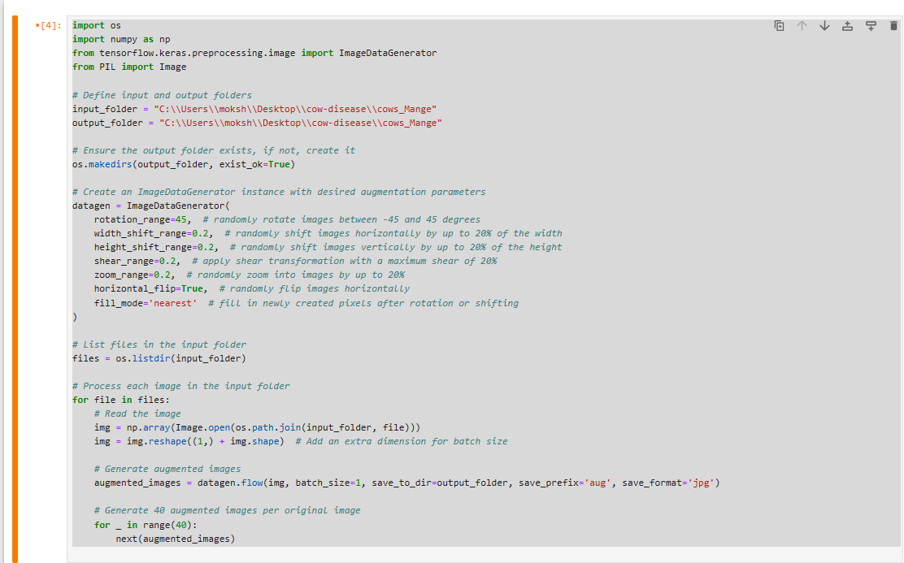

Slide 22
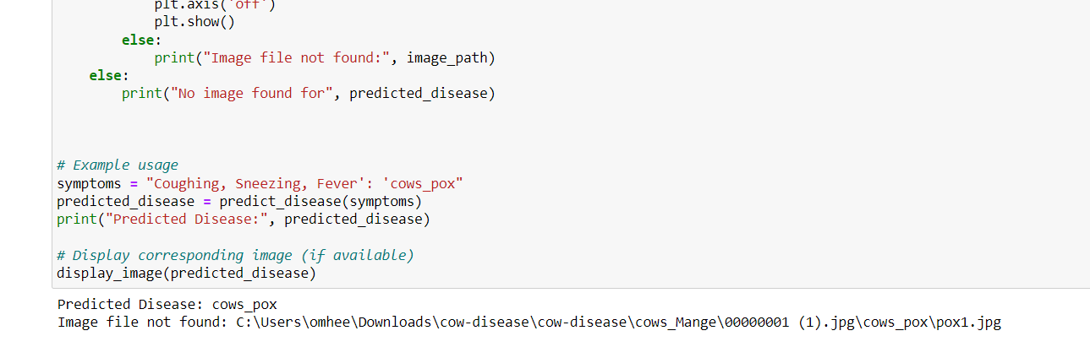

Slide 23
Accuracy
Model | Precision | Recall | F1-Score | Accuracy
MLP | 65% | 57% | 61% | 72%
Random Forest | 73% | 62% | 73% | 74.49%
CNN | 98% | 98% | 98% | 98%
Lime | 89% | 89% | 89% | 89%
DNN | 62% | 62% | 62% | 62%

Slide 24
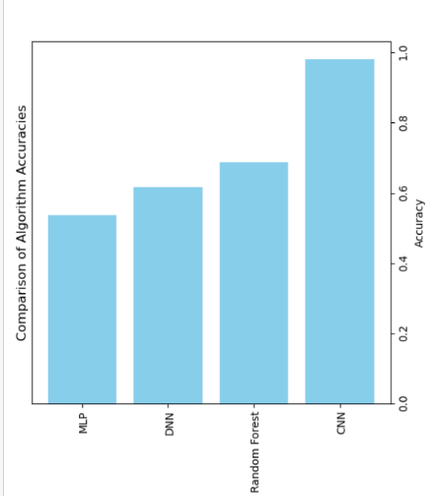
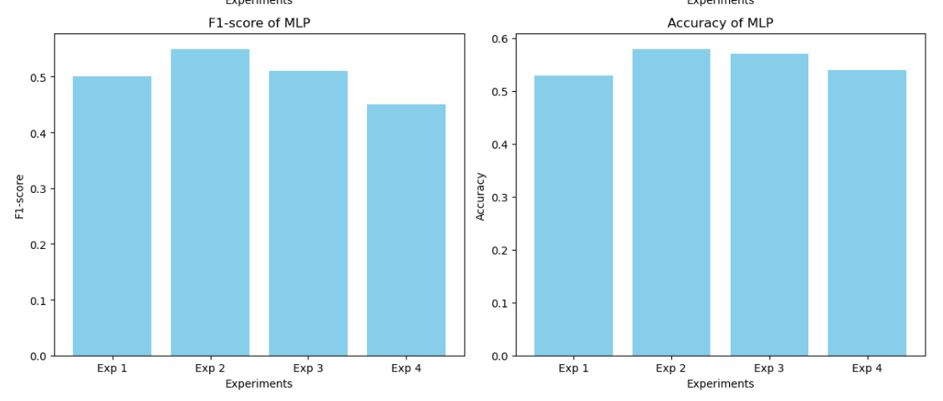
Accuracy Graph-

Slide 25
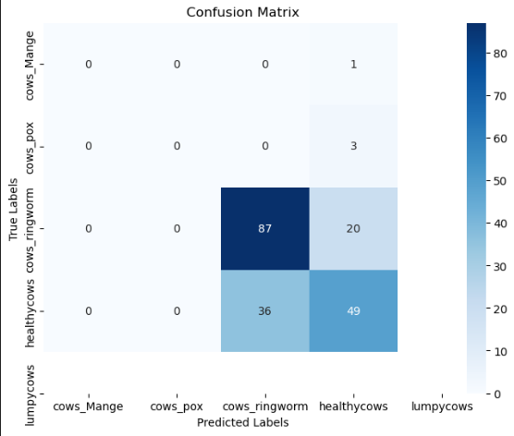
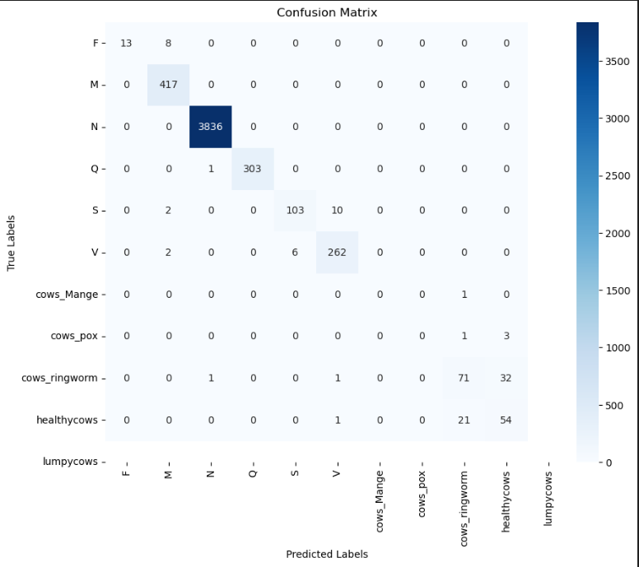
Confusion Matrix-
CNN
Random Forest

Slide 26
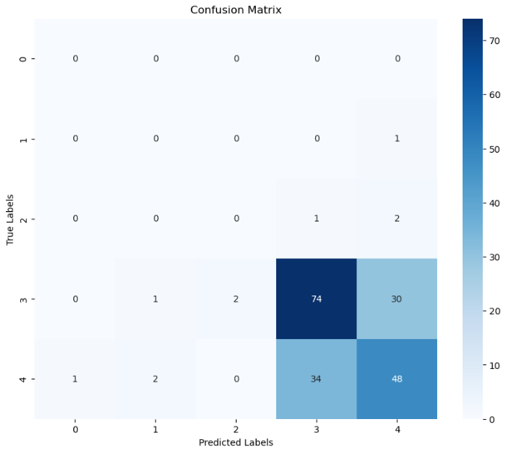
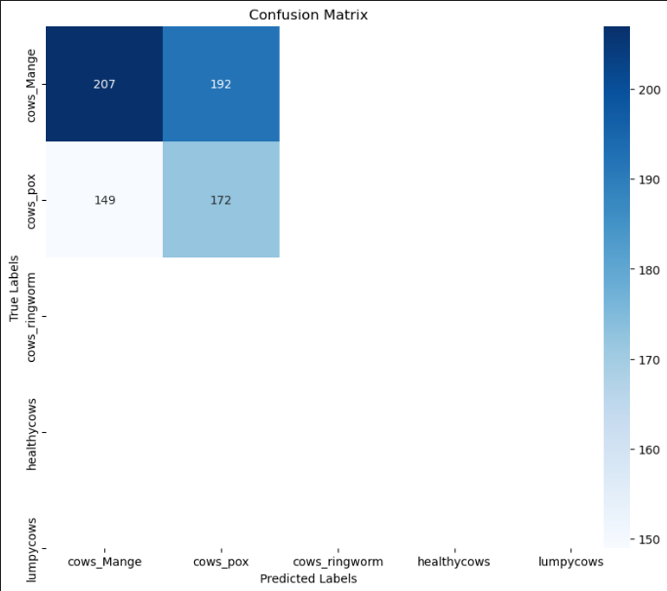
Confusion Matrix-
DNN
MLP

Slide 27
Application
1. Improved Livestock Health Monitoring
2. Preventive Veterinary Care
3. Reduced Antibiotic Use
4. Global Health Impact
5. Customized Treatment Plans
6. Optimized Breeding Programs
7. Continuous Monitoring and Predictive Analytics

Slide 28
Conclusion
Presents a critical advancement in safeguarding the health of cows, essential contributors to the dairy industry, agriculture, and cultural practices.
Despite significant research in disease detection for various organisms like plants and dogs, there is a notable gap in addressing cow diseases, particularly given the decreasing populations and economic impact of diseases on dairy production.
CNN offers a promising solution for automating disease detection in cows by analyzing health records and images, allowing for timely intervention and treatment.
Not only minimizes suffering for the cows but also prevents the spread of disease within the herd.
Our proposed model integrates image processing with a chatbot for predicting cow diseases, providing a unique and comprehensive solution.
By harnessing the power of AI and image analysis, we can revolutionize the way we approach cow disease detection.

Slide 29
References
1. H. I. Peyal et al., "Plant Disease Classifier: Detection of Dual-Crop Diseases Using Lightweight 2D CNN Architecture," in IEEE Access, vol. 11, pp. 110627-110643, 2023, doi: 10.1109/ACCESS.2023.3320686.
2. S. Hwang, H. K. Shin, J. M. Park, et al., “Classification of dog skin diseases using deep learning with images captured from multispectral imaging device,” Mol. Cell. Toxicol., vol. 18, pp. 299–309, 2022 1. DOI: 10.1007/s13273-022-00249-7.
3. T. J. Brinker, A. Hekler, J. S. Utikal, N. Grabe, D. Schadendorf, J. Klode, C. Berking, T. Steeb, A. H. Enk, and C. von Kalle, “Skin Cancer Classification Using Convolutional Neural Networks: Systematic Review,” J. Med. Internet Res., vol. 20, no. 10, e11936, 2018. DOI: 10.2196/11936. PMID: 30333097, PMCID: 6231861.
4. A. Upadhyay, G. Singh, S. Mhatre, et al., “Dog Skin Diseases Detection and Identification Using Convolutional Neural Networks,” SN Comput. Sci., vol. 4, p. 250, 2023. DOI: 10.1007/s42979-022-01645-5.
5. A. Khosla, N. Jayadevaprakash, B. Yao, and L. Fei-Fei, “Novel Dataset for Fine-Grained Image Categorization: Stanford Dogs,” in First Workshop on Fine-Grained Visual Categorization (FGVC), IEEE Conference on Computer Vision and Pattern Recognition (CVPR), 2011
6. Merrin Prasanna, N., Nagarau, C., Venkatesh, C., Subash Chandra Mouli, D., Riyazuddin, K., Rakesh Babu, B. (2024). Design and Development of Leaf Disease Detection Using the ML and Open CV for Tomato Plants. In: Kumar, A., Mozar, S. (eds) Proceedings of the 6th International Conference on Communications and Cyber Physical Engineering . ICCCE 2024. Lecture Notes in Electrical Engineering, vol 1096. Springer, Singapore. https://doi.org/10.1007/978-981-99-7137-4_4
Notes:
‹#›

Slide 30
References
7. Y. Zhang, C. Song and D. Zhang, "Deep Learning-Based Object Detection Improvement for Tomato Disease," in IEEE Access, vol. 8, pp. 56607-56614, 2020
8. K. Mridha, M. M. Uddin, J. Shin, S. Khadka and M. F. Mridha, "An Interpretable Skin Cancer Classification Using Optimized Convolutional Neural Network for a Smart Healthcare System," in IEEE Access, vol. 11, pp. 41003-41018, 2023
9. H. Al-Bashiri, O. Al-Hadhrami, A. Al-Areqi, M. Al-Rahmi, and S. Zeki. (2020). "A comprehensive review on automated disease diagnosis using artificial intelligence." Journal of Healthcare Engineering, vol. 2020, Article ID 2710472.
10. G. D. Maggio, G. Stocco, F. Pilla, F. Zorzi, and M. A. Coppola. (2017). "Machine Learning in the Agricultural Environment." Journal of Agricultural Engineering, vol. 48(1), pp. 1-16.
11. J. F. Mee, C. J. O’Neill, and M. Doherty. (2018). "Automated methods for detecting lameness and measuring analgesia in dairy cattle." Animal Welfare, vol. 27(2), pp. 169-183.
12. S. M. Chai, S. L. Yap, Y. H. Tan, S. N. Lim, and P. O. Ooi. (2018). "Disease detection in pineapple plants using machine learning techniques." Computers and Electronics in Agriculture, vol. 147, pp. 109-115.
Notes:
‹#›

Slide 31
References
13. G. Yue, P. Wei, Y. Liu, Y. Luo, J. Du and T. Wang, "Automated Endoscopic Image Classification via Deep Neural Network With Class Imbalance Loss," in IEEE Transactions on Instrumentation and Measurement, vol. 72, pp. 1-11, 2023
14. B. Xi, J. Li, Y. Li, R. Song, W. Sun and Q. Du, "Multiscale Context-Aware Ensemble Deep KELM for Efficient Hyperspectral Image Classification," in IEEE Transactions on Geoscience and Remote Sensing, vol. 59, no. 6, pp. 5114-5130, June 2021
15. S. Kumar, M. K. Chaube and S. Kumar, "Secure and Sustainable Framework for Cattle Recognition Using Wireless Multimedia Networks and Machine Learning Techniques," in IEEE Transactions on Sustainable Computing, vol. 7, no. 3, pp. 696-708, 1 July-Sept. 2022
Notes:
‹#›

